Slide 1


LEGO-Gen
BENEDIKT FARAG & STEVEN WARD
Department of Statistics and Data Science, Yale University

Slide 2
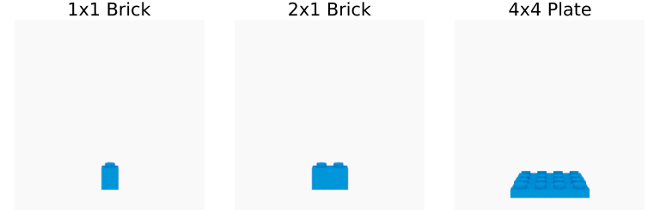
Objective
Given a target image, how can we reconstruct the 3D structure as LEGO objects?
A lot of physical constraints when building LEGO objects
Connecting bricks, non-intersecting, orientation, brick thickness etc.
We built a generative model to generate LEGO structures with a brick vocabulary of size 3:

Slide 3
Naïve approach: Metropolis Hastings
Prior samples number of bricks N, and its type, orientation and location
Two kernels: Brick count kernel and mutate kernel
Three methods
Layering: One View
Decomposes the problem into layers using stage-wise mcmc
Optimizes layer-by-layer and “freezes” before moving to the next
Layering: Two Views
Same methodology as the one view method, but now uses two views instead of single front view
Benefits from 3D reasoning about the ground truth

Slide 4
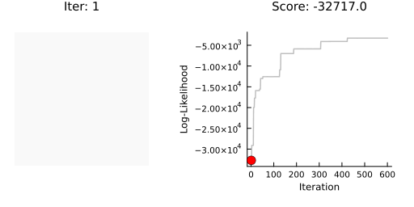
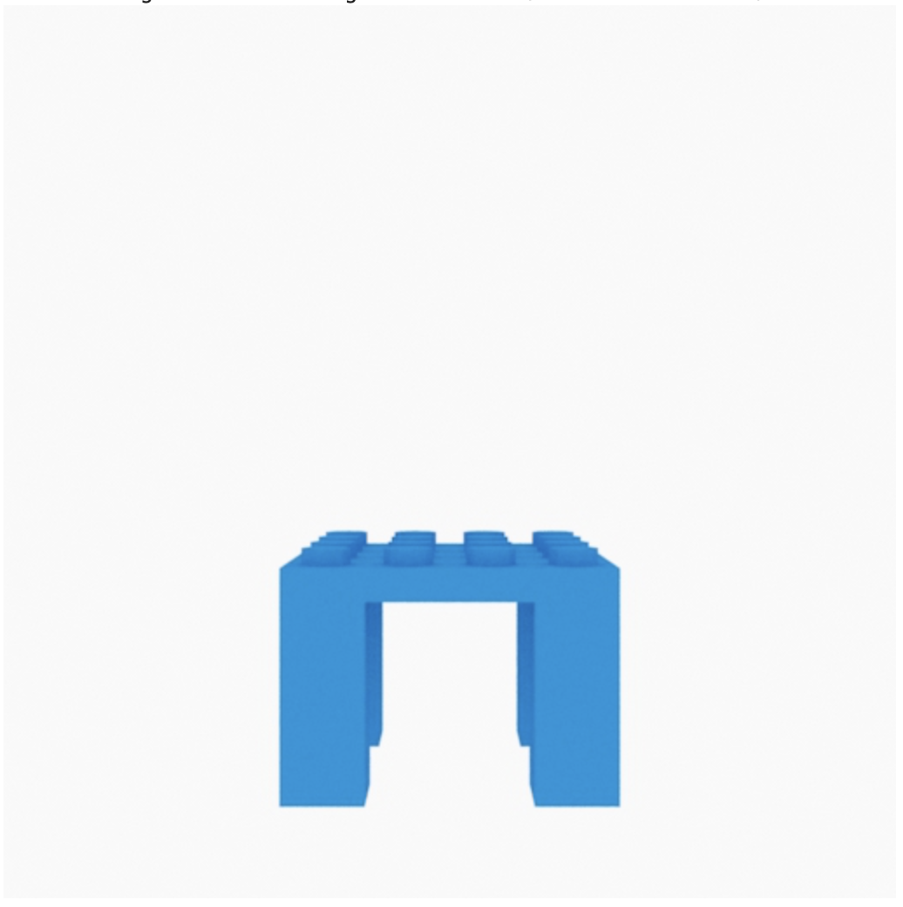
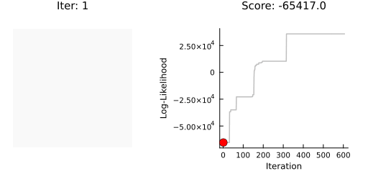
Metropolis Hastings
Results
Layer: Two Views
Table Ground Truth

Slide 5
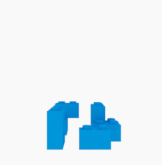
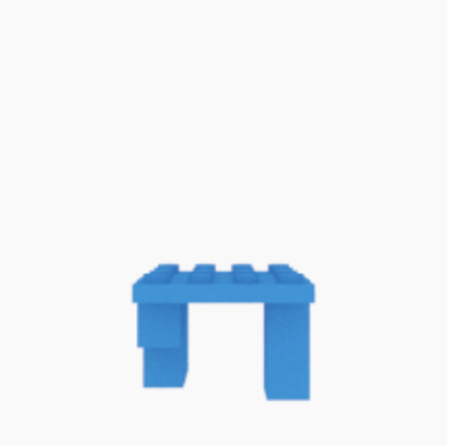

MAP estimates
Metropolis Hastings
Layer: One View
Layer: Two Views

Slide 6
Thank you!
Any questions?

